Slide 1
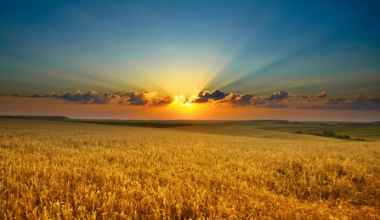

All Things Bright and Beautiful
599
So-G

Slide 2
Chorus
All things bright and beautiful,
All creatures great and small,
All things wise and wonderful:
The Lord God made them all.

Slide 3
1
Each little flow’r that opens,
Each little bird that sings,
He made their glowing colours,
He made their tiny wings.

Slide 4
Chorus
All things bright and beautiful,
All creatures great and small,
All things wise and wonderful:
The Lord God made them all.

Slide 5
2
The purple-headed mountains,
The river running by,
The sunset and the morning
That brightens up the sky.

Slide 6
Chorus
All things bright and beautiful,
All creatures great and small,
All things wise and wonderful:
The Lord God made them all.

Slide 7
3
The cold wind in the winter,
The pleasant summer sun,
The ripe fruits in the garden,
He made them every one.

Slide 8
Chorus
All things bright and beautiful,
All creatures great and small,
All things wise and wonderful:
The Lord God made them all.

Slide 9
4
The tall trees in the greenwood,
The meadows where we play,
The rushes by the water,
To gather every day.

Slide 10
Chorus
All things bright and beautiful,
All creatures great and small,
All things wise and wonderful:
The Lord God made them all.

Slide 11
5
He gave us eyes to see them,
And lips that we might tell
How great is God Almighty,
Who has made all things well.

Slide 12
Chorus
All things bright and beautiful,
All creatures great and small,
All things wise and wonderful:
The Lord God made them all.

