Slide 1


Ancient Words
369a
X

Slide 2
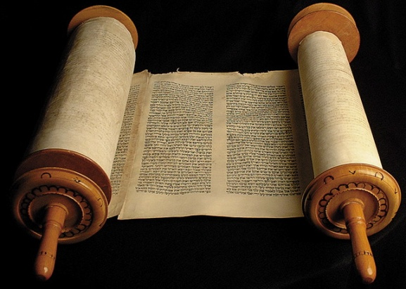
1
Holy Words long preserved
For our walk in this world
They resound with God’s own heart
Oh let the Ancient Words impart

Slide 3
Chorus
A n c i e n t Words ever true
Changing me and changing you
We have come with open hearts
Oh, let the ancient words impart

Slide 4
2
Words of life, words of hope
Give us strength, help us cope
In this world, where e’er we roam
Ancient words will guide us home

Slide 5
Chorus
A n c i e n t Words ever true
Changing me and changing you
We have come with open hearts
Oh, let the ancient words impart

Slide 6
3
Holy words of our faith
Handed down to this age
Came to us through s a c r i f i c e
Believe the faithful words of Christ

Slide 7
Chorus
A n c i e n t Words ever true
Changing me and changing you
We have come with open hearts
Oh, let the ancient words impart
X2

