Slide 1
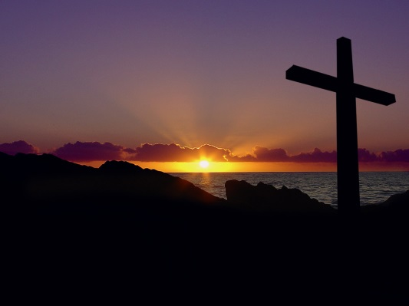

My Sins Were Higher
5 7 3
E

Slide 2
1
My sins were
Higher than the mountain
When the Lord JUSTIFIED me
My sins were
Higher than the mountain
When the Lord SANCTIFIED me

Slide 3

Chorus
S i n g i n g g l o r y ! Hallelujah
When the fire came down (X3)
Singing glory, hallelujah, when the fire …
When the Lord JUSTIFIED me
S i n g i n g g l o r y ! Hallelujah
When the fire came down (X3)
Singing glory, hallelujah, when the fire …
When the Lord SANCTIFIED me

Slide 4
2
My sins were
Deeper than the ocean
When the Lord JUSTIFIED me
My sins were
Deeper than the ocean
When the Lord SANCTIFIED me

Slide 5
Chorus
S i n g i n g g l o r y ! Hallelujah
When the fire came down (X3)
Singing glory, hallelujah, when the fire …
When the Lord JUSTIFIED me
S i n g i n g g l o r y ! Hallelujah
When the fire came down (X3)
Singing glory, hallelujah, when the fire …
When the Lord SANCTIFIED me

Slide 6
3
My sins were
Wider than the whole world
When the Lord JUSTIFIED me
My sins were
Wider than the whole world
When the Lord SANCTIFIED me

Slide 7
Chorus
S i n g i n g g l o r y ! Hallelujah
When the fire came down (X3)
Singing glory, hallelujah, when the fire …
When the Lord JUSTIFIED me
S i n g i n g g l o r y ! Hallelujah
When the fire came down (X3)
Singing glory, hallelujah, when the fire …
When the Lord SANCTIFIED me

Slide 8
4
My sins were
Flowing like a river
When the Lord JUSTIFIED me
My sins were
Flowing like a river
When the Lord SANCTIFIED me

Slide 9
Chorus
S i n g i n g g l o r y ! Hallelujah
When the fire came down (X3)
Singing glory, hallelujah, when the fire …
When the Lord JUSTIFIED me
S i n g i n g g l o r y ! Hallelujah
When the fire came down (X3)
Singing glory, hallelujah, when the fire …
When the Lord SANCTIFIED me

