Slide 1
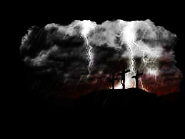

On Calvary’s Brow
548
G

Slide 2
On Calvary’s brow my Saviour died.
’Twas there my Lord was crucified;
’Twas on the cross He bled for me,
And purchased there my pardon free.
1

Slide 3
O Calvary! Dark Calvary!
Where Jesus shed His blood for me;
O Calvary! Blessed Calvary!
’Twas there my Saviour died for me.
Chorus

Slide 4
’Mid rending rocks and darkening skies
My Saviour bows His head and dies;
The opening veil reveals the way
To life divine and endless day.
2

Slide 5
O Calvary! Dark Calvary!
Where Jesus shed His blood for me;
O Calvary! Blessed Calvary!
’Twas there my Saviour died for me.
Chorus

Slide 6
O Jesus, Lord, how can it be
That Thou should give Thy life for me,
To bear the cross and agony
In that dread hour on Calvary!
3

Slide 7
O Calvary! Dark Calvary!
Where Jesus shed His blood for me;
O Calvary! Blessed Calvary!
’Twas there my Saviour died for me.
Chorus

