Slide 1

Peace, Peace, Peace
323
A

Slide 2
1
Peace, Peace, Peace
Halleluiah, Peace
In my Father’s house,
There is peace.
Peace, Peace, Peace,
Halleluiah, Peace.

Slide 3
2
Life, Life, Life,
Halleluiah, Life
In my Father’s house,
There is life.
Life, Life, Life,
Halleluiah, Life.

Slide 4
3
Joy, Joy, Joy,
Halleluiah, Joy.
In my Father’s house,
There is Joy.
Joy, Joy, Joy,
Halleluiah, Joy.

Slide 5
4
Grace, Grace, Grace,
Halleluiah, Grace
In my Father’s house,
There is Grace.
Grace, Grace, Grace,
Halleluiah, Grace.

Slide 6
5
Love, Love, Love,
Halleluiah, Love
In my Father’s house,
There is Love.
Love, Love, Love,
Halleluiah, Love.

Slide 7
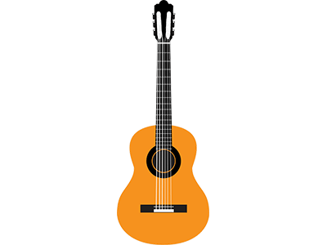
6
Hope, Hope, Hope,
Halleluiah, Hope.
In my Father’s house,
There is Hope.
Hope, Hope, Hope,
Halleluiah, Hope.
Français

Slide 8
7
Joie, Joie, Joie,
Alléluia, Joie.
Dans la maison de mon Père
Il y a de la Joie.
Joie, Joie, Joie,
Alléluia, Joie.

Slide 9
8
Paix, Paix, Paix,
Alléluia, Paix.
Dans la maison de mon Père
Il y a de la Paix.
Paix, Paix, Paix,
Alléluia, Paix.

Slide 10
9
Vie, Vie, Vie,
Alléluia, Vie.
Dans la maison de mon Père
Il y a de la Vie.
Vie, Vie, Vie,
Alléluia, Vie.

Slide 11
10
Grace, Grace, Grace,
Alléluia, Grace.
Dans la maison de mon Père
Il y a de la Grace.
Grace, Grace, Grace,
Alléluia, Grace.

