Slide 1

Praise to the Lord, the Almighty
( + Solfa Tonic )
637
G

Slide 2
1
Praise to the Lord, the Almighty,
The King of creation!
O my soul, praise Him, for He is
Thy health and salvation!
ALL YE WHO HEAR
Now to His temple draw near;
Praise Him in glad adoration.
( X2 )

Slide 3
2
Praise to the Lord! Over all things
He gloriously reigneth;
Shelters thee under His wings,
Yes, so gently sustaineth!
HAST THOU NOT SEEN
How all thou needest hath been;
Granted in what He ordaineth?
( X2 )

Slide 4
3
Praise to the Lord, who does prosper
Thy work and defend thee;
Surely His goodness and mercy
Shall ever attend thee;
PONDER ANEW
What the Almighty can do;
Through His great love He befriend thee..
( X2 )

Slide 5
4
Praise to the Lord, who when tempest
Their warfare are waging;
Who, when the elements madly
Around thee are raging;
COMMAND THEM CEASE,
Turneth their fury to peace;
Whirlwinds and waters obeying!
( X2 )

Slide 6
5
Praise to the Lord, oh, let all that
Is in me adore Him!
All that hath life and breath, come now
With praises before Him;
LET THE ‘AMEN’
Sound from His people again;
Gladly we worship before Him.
( X2 )
Bonga iNkosi

Slide 7
6
Bonga iNkosi, ituswe
Ngalokh’ esinakho,
Udumo lwakhe luvuswe
Ngabantu bomhlaba.
NITHI ‘AMENI’!
Masibabaze iNkosi,
Kuse kube-naphakade.
( X2 )

Slide 8
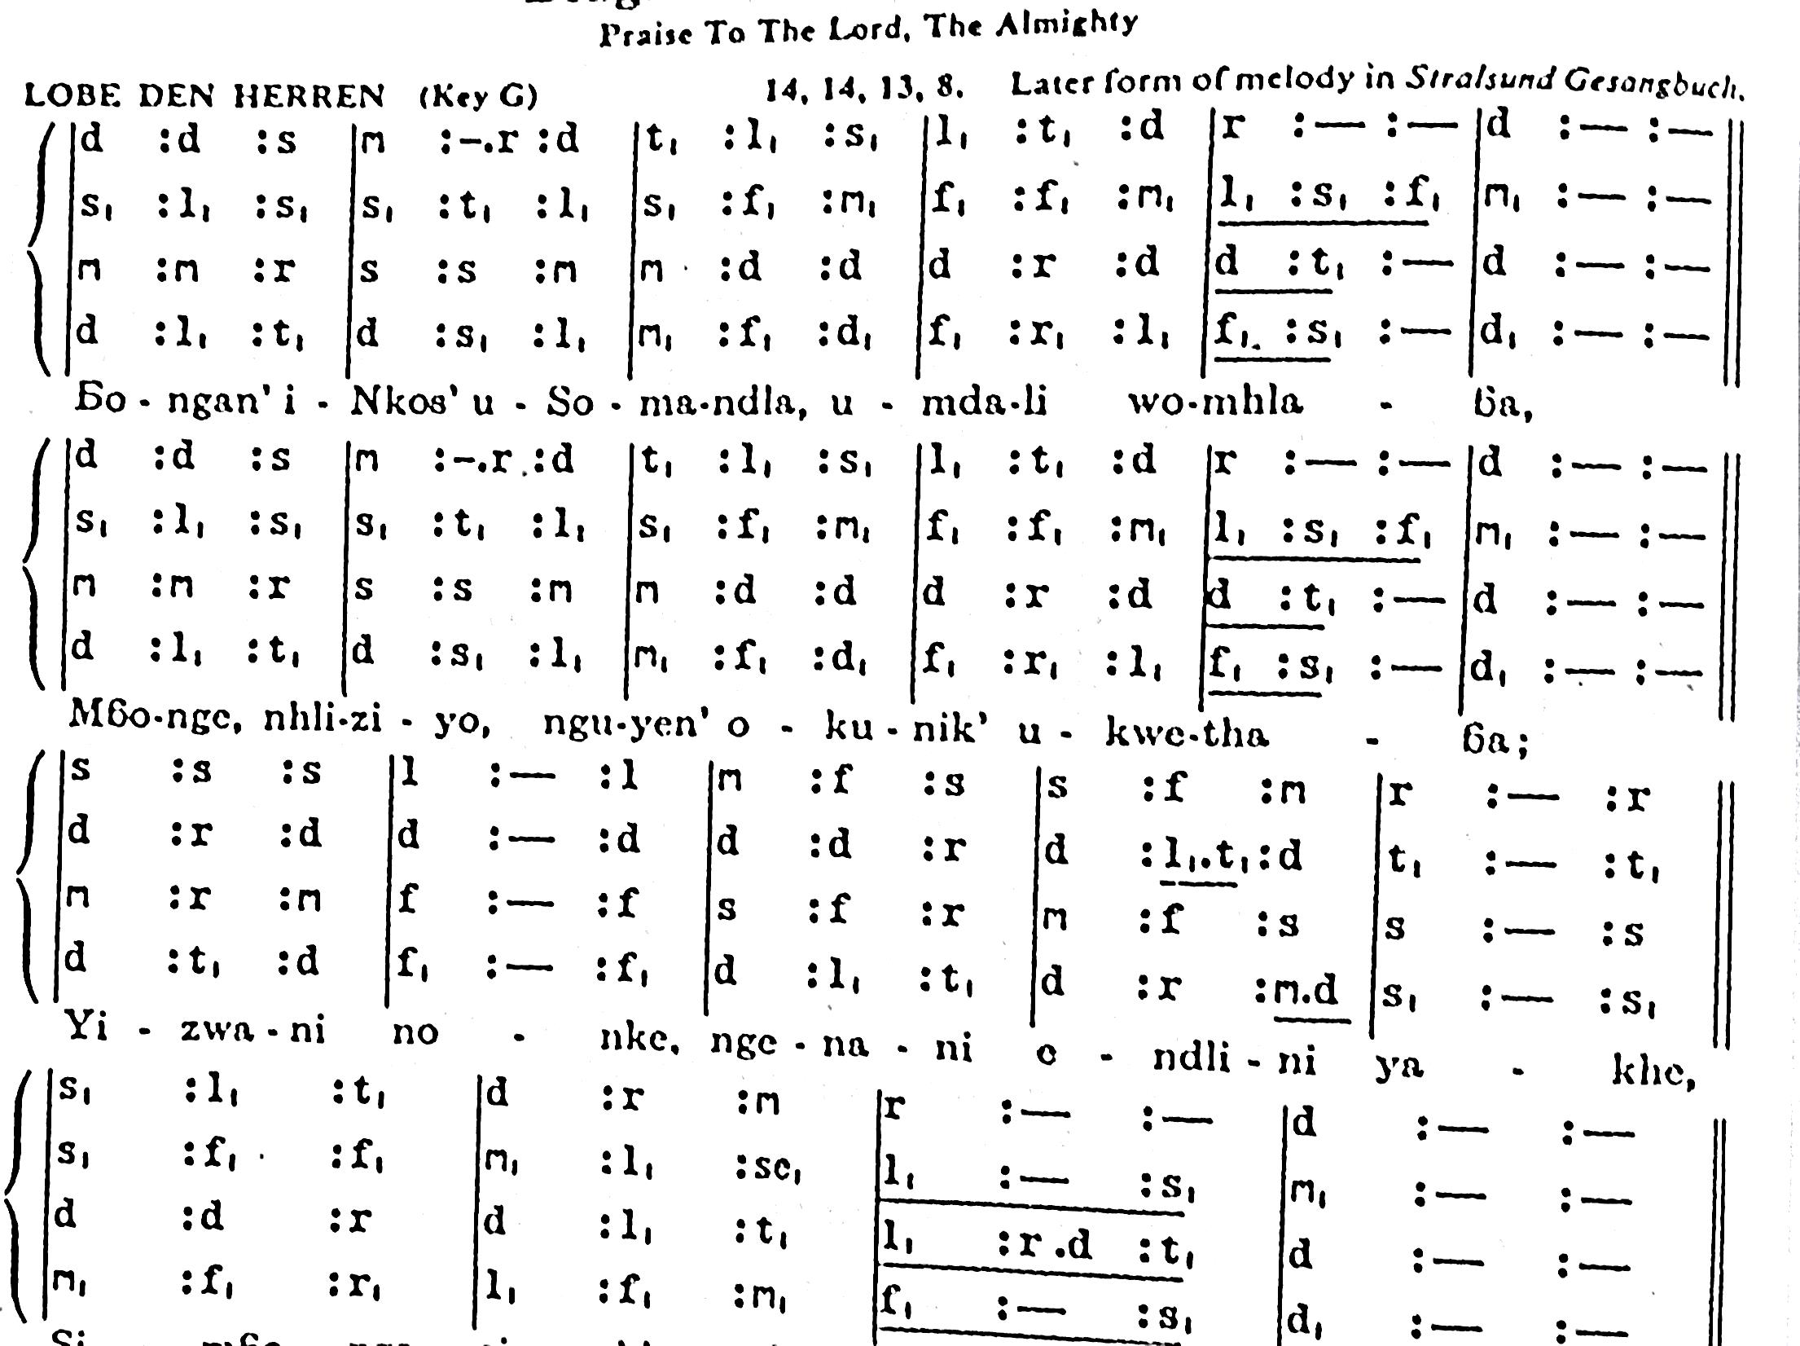
Praise to the Lord! O ver all things He glo rious ly rei - - gneth - -
O my soul, praise Him, for He is Thy health and sal va - - tion - -
X2
ALL YE WHO HEAR - - Now to His tem ple draw near - -
Praise Him in glad a do ra - - tion - -

