Slide 1

Precious Promise
God Has Given
[+ solfa]
805
G

Slide 2
1
Precious promise God has given
To the weary passer-by,
On the way from earth to Heaven,
“I will guide thee with Mine Eye.”

Slide 3
Chorus
  I will guide thee, I will guide thee,
  I will guide thee with Mine eye;
  On the way from earth to Heaven,
  I will guide thee with Mine Eye.

Slide 4
2
When temptations almost win thee
And thy trusted watchers fly,
Let this promise ring within thee,
“I will guide thee with Mine Eye.”

Slide 5
Chorus
  I will guide thee, I will guide thee,
  I will guide thee with Mine eye;
  On the way from earth to Heaven,
  I will guide thee with Mine Eye.

Slide 6
3
When thy secret hopes have perished
In the grave of years gone by,
Let this promise still be cherished,
“I will guide thee with Mine Eye.”

Slide 7
Chorus
  I will guide thee, I will guide thee,
  I will guide thee with Mine eye;
  On the way from earth to Heaven,
  I will guide thee with Mine eye.

Slide 8
4
When the shades of life are falling
And the hour has come to die,
Hear thy trusty Pilot calling,
“I will guide thee with Mine Eye.”

Slide 9
Chorus
  I will guide thee, I will guide thee,
  I will guide thee with Mine eye;
  On the way from earth to Heaven,
  I will guide thee with Mine Eye.

Slide 10
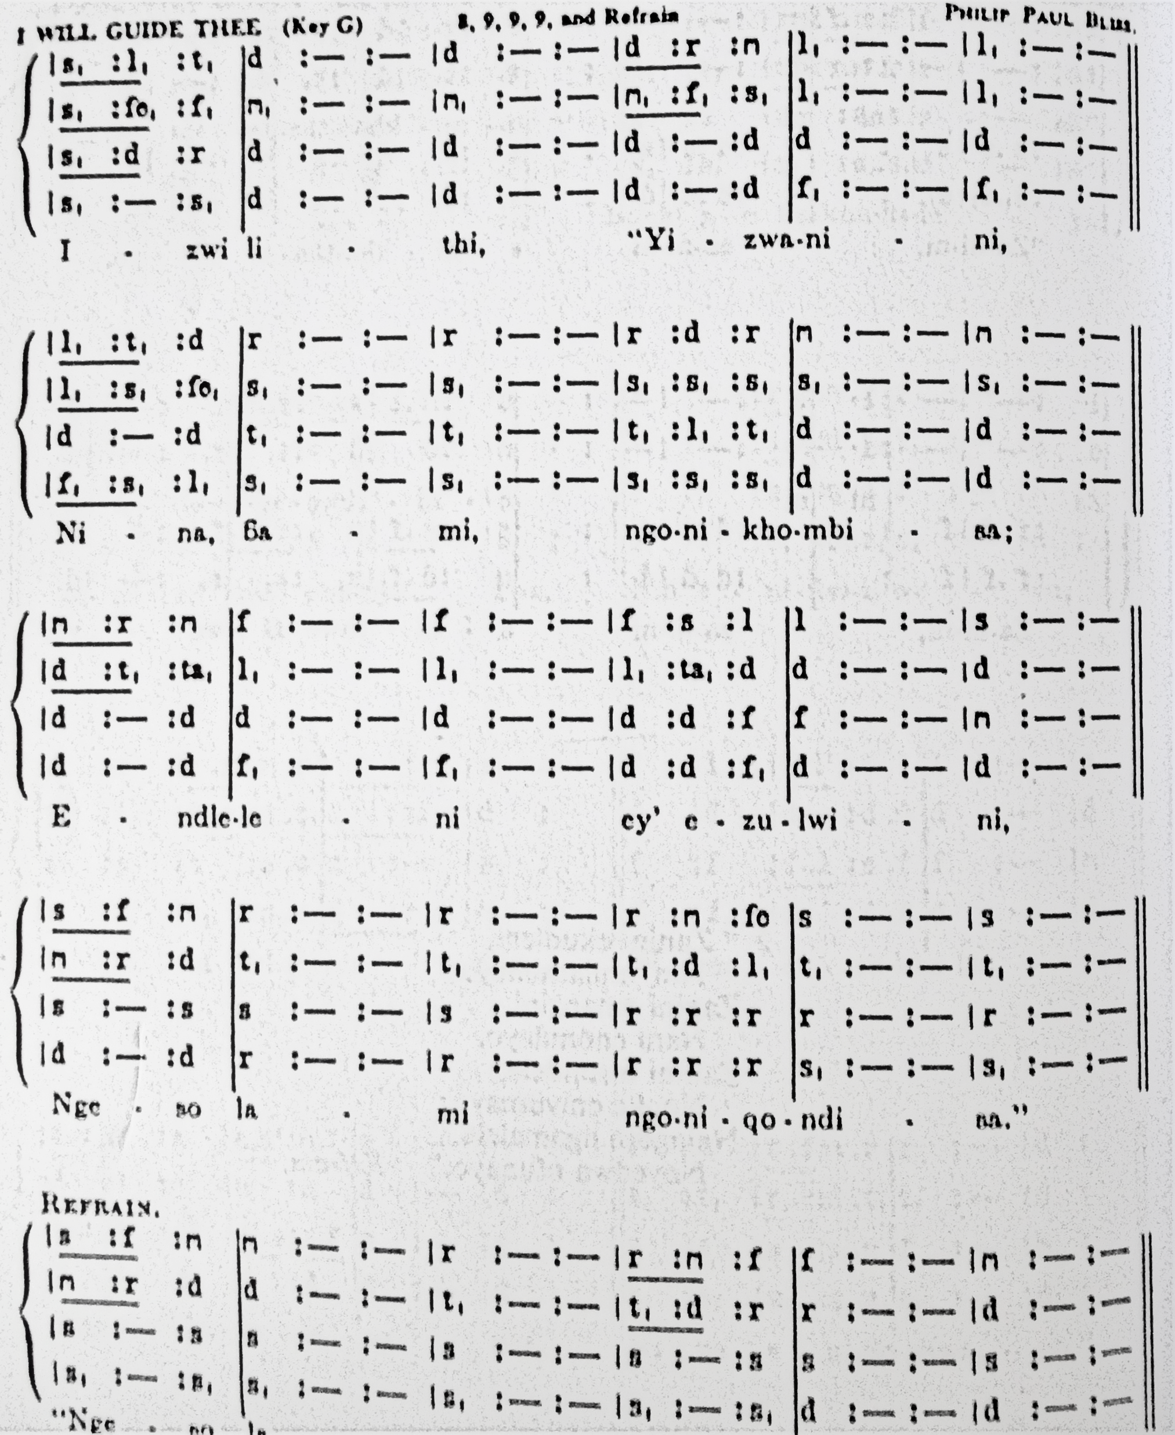
Precious Promise

Slide 11


