Slide 1

BLEST BE THE TIE
[+ solfa]
110
F#

Slide 2
1
Blest be the tie that binds
Our hearts in Christian love;
The fellowships of kindred minds
Is like to that above.

Slide 3
2
Before our Father’s throne,
We pour our ardent prayers;
Our fears, our hopes, our aims are one,
Our comforts and our cares.

Slide 4
3
We share our mutual woes,
Our mutual burdens bear;
And often for each other flows
The sympathizing tear.

Slide 5
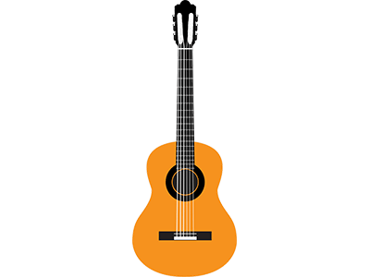
4
When we asunder part,
It gives us inward pain;
But we shall still be joined in heart,
And hope to meet again.
Itamb’ ebophela

Slide 6
5
Itamb’ebophela
Inhliziyo zethu;
Kulo uthando lwezulu,
Sibusiso sethu.

Slide 7
6
Phambili kwes’hlalo
Sizo zincengela;
Ukwesaba nokulila
Kwethu ku yophela.

Slide 8
7
Inhlupheko zethu,
Nayo imithwalo;
Noku khalelana kwethu,
Konke ku ndawonye.

Slide 9
8
Nxase sehlukana
kubanga usizi;
Kodwa siyethemba sizo,
Hlangana phambili.

Slide 10


