Slide 1

This old world can never
690
G

Slide 2
1
This old world
Can never hold me anymore
I’ll be gone
For I’ve heard the trumpet of God
And I have
My wedding garment on !

Slide 3
2
This old world
Can never hold me anymore
I’ll be gone
For I’ve seen the restoration
And I have
My wedding garment on !

Slide 4
3
This old world
Can never hold me anymore
I’ll be gone
For I’ve seen the Groom’s coming signs
And I have
My wedding garment on !

Slide 5
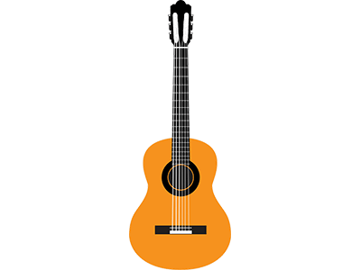
4
This old world
Can never hold me anymore
I’ll be gone
For I trust the promise of God
And I have
My wedding garment on !

Slide 6
5
This old world
Can never hold me anymore
I’ll be gone
For His Word has sanctified me
And I have
My wedding garment on !

Slide 7
6
This old world
Can never hold me anymore
I’ll be gone
God has poured His Life into me
And I have
My wedding garment on !

Slide 8
7
This old world
Can never hold me anymore
I’ll be gone
God has poured His Love into me
And I have
My wedding garment on !

Slide 9
8
This old world
Can never hold me anymore
I’ll be gone
For by Grace, the Lord shall take me
And I have
MY WEDDING GARMENT ON !

