Slide 1
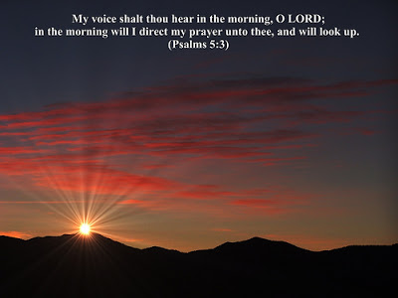

Burdens Are Lifted at Calvary
635
E

Slide 2
1
Days are filled with sorrow and care,
Hearts are lonely and drear;
Burdens are lifted at Calvary,
Jesus is very near.

Slide 3
Chorus
Burdens are lifted at Calvary,
Calvary, Calvary;
Burdens are lifted at Calvary,
Jesus is very near.

Slide 4
2
Cast your care on Jesus today,
Leave your worry and fear;
Burdens are lifted at Calvary,
Jesus is very near.

Slide 5
Chorus
Burdens are lifted at Calvary,
Calvary, Calvary;
Burdens are lifted at Calvary,
Jesus is very near.

Slide 6
3
Troubled soul, the Saviour can feel
Every heartache and tear;
Burdens are lifted at Calvary,
Jesus is very near.

Slide 7
Chorus
Burdens are lifted at Calvary,
Calvary, Calvary;
Burdens are lifted at Calvary,
Jesus is very near.

