Slide 1
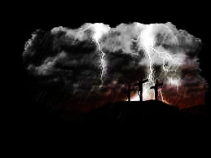

When I Survey the Cross
(Nxangibona)
426^{-D-}
A

Slide 2
1
When I survey the wondrous cross
On which the Prince of glory died
My richest gain
I count but loss
And pour contempt
On all my pride
X2

Slide 3
2
Forbid it, Lord, that I should boast
Save in the death of Christ, my God
All the vain things
Which charm me most
I sacrifice
Them to His blood
X2

Slide 4
3
See from His head, His hands, His feet
Sorrow and love flow mingled down
Did e’er such love
And sorrow meet
Or thorns compose
So rich a crown?
X2

Slide 5
4
His dying crim-son like a robe
Spreads o’er His bo-dy on the tree
Then am I dead
To all the world
And all the world
Is dead to me
X2

Slide 6
5
Were the whole realm of nature mine
That were a pre-sent far too small
Love so ama-
zing, so divine,
Demands my soul,
My life, my all.
X2

