Slide 1

CHRIST THE LORD
IS RISEN !
545
E

Slide 2
1
Christ, the Lord, is risen today;
Raise your joy and triumph high.
Alleluia! Alleluia!
Alleluia! Alleluia!

Slide 3
2
Love’s redeeming work is done;
Fought the fight, the battle won.
Alleluia! Alleluia!
Alleluia! Alleluia!

Slide 4
3
Christ has burst the gates of hell;
Death in vain forbids His rise.
Alleluia! Alleluia!
Alleluia! Alleluia!

Slide 5
4
Our Glorious King lives again!
Where, o death, is now your sting?
Alleluia! Alleluia!
Alleluia! Alleluia!

Slide 6
5
Hymns of praise then let us sing;
Unto Christ, our heavenly King.
Alleluia! Alleluia!
Alleluia! Alleluia!

Slide 7
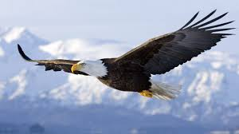
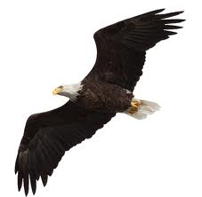
6
Soar we now where Christ has led;
Made like Him, like Him we rise.
Alleluia! Alleluia!
Alleluia! Alleluia!

